Slide 1
HVM SBFT Intro

Slide 2
What is SBFT
Structural Based Functional Test
Why Structural?
This is how we measure the effectiveness of the test.
Why Functional?
We use the functionalities of the CORE/SOC to make it “test” itself.
Array and Scan are not enough.

Slide 3
HVM SBFT Stages
LOAD CPL
RUN UCODE
CHECK
RESET PCODE
We need to load the test into one of the caches (MLC/LLC), we do this via CPL.
We load in cache because we don’t have external memory on HVM.
We make the core execute the content and wait some time for it to finish.
The way we execute the content is the content “flavors” we have.
We check the results in multiple ways to ensure it got the passing point.

Slide 4
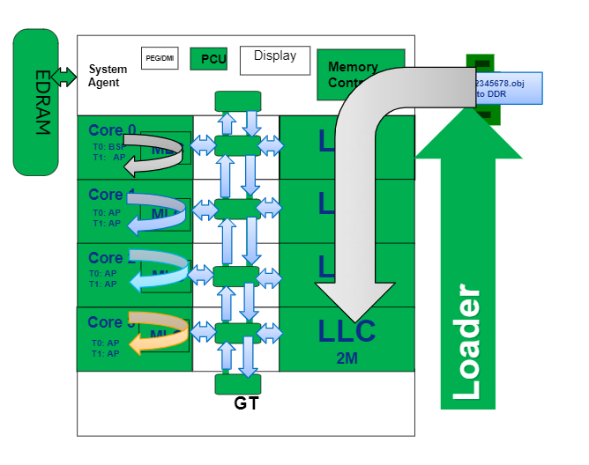
Why do we need SBFT
How PPV/System looks:
Pros:
Is a closer type of test close to PPV/System.
Allows us to port or develop somehow alike content from different platforms to HVM.
Doesn’t rely on new DFT.
Cons:
Is expensive, takes a lot of time to load and run.
Is complex, enabling and debugging are a challenge.

Slide 5
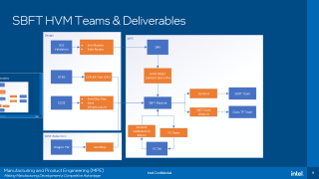
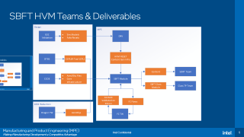
SBFT HVM Teams & Deliverables

Slide 6
SBFT “Flavors”

Slide 7
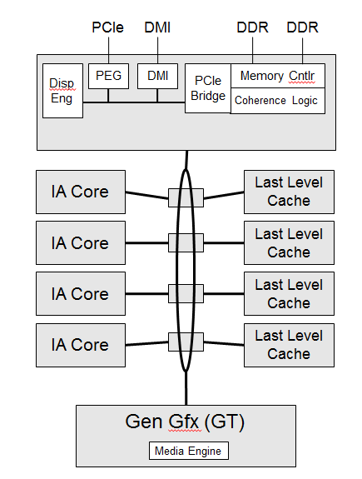
MLC
Core Isolated Content
Test loaded in MLC cache.
No traffic allowed outside core.
All cores runs the same code @ same time.
How to check it:
Sig-mode
Archstate

Slide 8
SLC
“Tile” Isolated Content
Test loaded in LLC cache.
No traffic allowed outside the tile.
Only communication between the core and the collocated CHA is allowed.
All cores runs the same code @ same time.
How to check it:
Sig-mode
Archstate

Slide 9
FC
SOC Isolated Content
Test loaded in LLC cache.
Same as SLC to support UTC.
No traffic allowed outside the SOC.
We cannot go to the memories or PCIe with requests.
Closest to System/PPV we could be.
Usually, 1 core wakes up and wake the other cores.
How to check it:
Archstate
Self-checks.

Slide 10
SBFT “Sub Flavors”

Slide 11
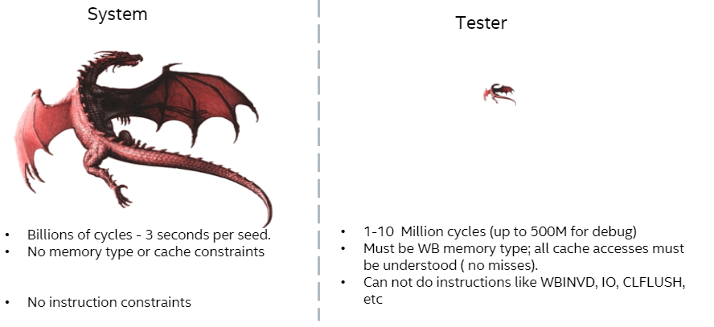
SLC/FC - Dragon
Same conditions as SLC or FC
Content is created for stress.
Not structurally measured.
No coverage data.
Effectiveness is based on DPM impact.
Even more expensive than SLC.
Multiple types of algorithms for best coverage on System.

Slide 12
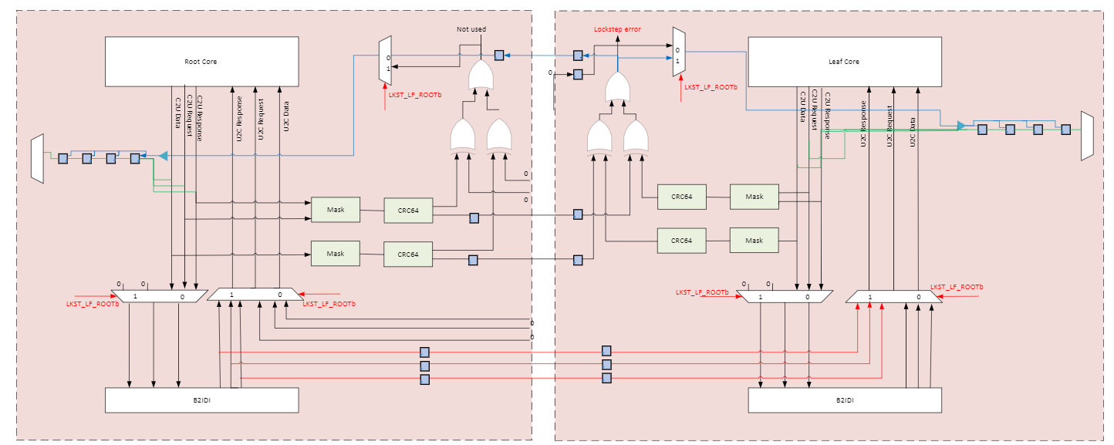
SLC – Lockstep Widget

Slide 13
SLC – Lockstep Content
Same content as SLC.
Different configuration before running.
Content is created to ensure 2 cores can be synchronized together.
Key items:
1 core request via IDI.
1 response duplicates to both cores.
Comparison checkers compare every request.

Slide 14
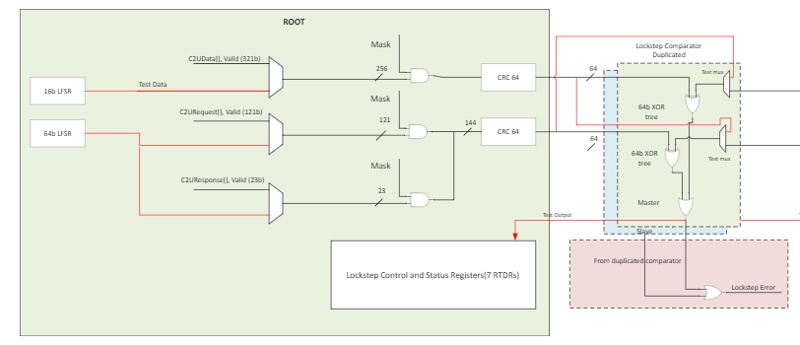
SLC – Lockstep BIST
Not really Functional.
BIST = Built in-Self Test
We program LFSRs to “simulate” core traffic thru checkers.

Slide 15
FC - MOSBFT
Test intent is to generate traffic on the MESH/CCF area.
I/O area
MEMSS
CCF area
UNCORE Configuration is faster to enable.

Slide 16
FC - MPM
Test intent is to generate traffic from the cores to MC
I/O area
MEMSS
UNCORE Configuration is complex.
Before the content executes the path between to the MemSS needs programing
Needs Memory Read Return feature Enabled.
This returns data in case a request appear
CCF area

Slide 17
FC – NC (Non-POR for 7nm)
Test intent is to generate traffic from the cores to NC
I/O area
MEMSS
UNCORE Configuration is complex.
Before the content executes the path between to the IO needs programing
Needs ATM feature Enabled.
This returns data in case a request appear
CCF area

Slide 18
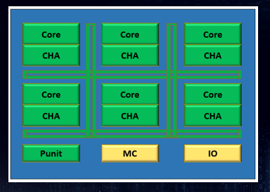
FC - PM
What is?
Special states to reduce energy consumption.
Challenges
Non-deterministics.
Complex content development.
Advantages
Better coverage.
Reduces DPM.

Slide 19
SBFT Checks

Slide 20
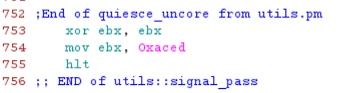
Arch-State - DR0
UCODE
RESET
CONTENT
HLT DR0 <= EBX
DR0 STROBE TO ACED
Most of the contents will perform these 2 instructions (mov and hlt) at the end of the code as a “passing” signature
Ucode “hlt” instruction will copy the EBX value into one of the debug registers (DR0) under special SBFT conditions.

Slide 21
Self-Signature
Coverage is a measure of all the gates the content toggle and observe.
Content could be toggling every single gate, if we cannot observe it we cannot consider it covered.
Signatures increases our observability points, hence, increase SBFT coverage.
In SBFT servers we don’t check signature, we compare each core signature against reference core.
PROs:
No need to check what we are strobing.
CONs:
New infra and DFT required.

Slide 22
SBFT Challenges on Pre-silicon
0p5
DFT Validation
0p8
MLC Breath to 100%
1p0
MLC Depth to 100%
Tech Readiness
TI
Definitions for new DFTs.
Definition for core requirements.
Not so involver currently, we want to change this ☺
CPL Validation
Content generation readiness.
Very basic MLC/SLC test.
SLC Breath to 100%
FC Breath to 80%
SLC Depth to 100%
FC Depth to 100%
HVM infrastructure ready.
TP Template validation done.
TP ready.
Content generation ready.
Content audits.
Keep increasing our validated content numbers.
Content specifics debugs.

Slide 23
SBFT Challenges on Post-silicon
ES1
100% Content on all sockets
ES2
QS
Power-On
PRQ
90% Content single socket.
All the infrastructure validated.
We start the DPM reduction efforts
Keep DPM reduction efforts.
Improve Yield usually above ~95%.
POST PRQ
CSE -> We ensure cold is not needed.
EQA -> We ensure QA it’s also not required.
Yield close to PHI ~95% Hot/Cold.
Validation require around 5000k units
Validation require around 5000k units
QA close to 97%
DPM close to 600.
Invest on complex TTR efforts.

